Slide 1







Stack Overflow Survey-Data Analysis And Dashboard
Suvetha
13/04/2024

Slide 2



OUTLINE
Executive Summary
Introduction
Methodology
Results
Visualization – Charts
Dashboard
Discussion
Findings & Implications
Conclusion
Appendix

Slide 3

EXECUTIVE SUMMARY
CURRENT TECHNOLOGY
Top 10 Languages
Top 10 Databases
Platforms
Top 10 Web Frames
FUTURE TECHNOLOGY TREND
Top 10 Languages for the Next Year
Top 10 Databases for the Next Year
Platforms for the Next Year
Top 10 Web Frames for the Next Year
Future Technology Trend
DEMOGRAPHICS
Respondent Classified By Gender
Respondent Count By Countries
Respondent Count By Age
Respondent Count By Gender, Classified By Formal Educational Level

Slide 4

INTRODUCTION
Collecting the Top Programming Skills in demand include job posting, training portals and Surveys.
Analyzing the data and Identify the insights of Top 10 Languages and Databases Skills.
Scraping the Internet Websites and Accessing APIs data in various Formats in csv files, excel sheets and databases.

Slide 5

METHODOLOGY
Collecting Data using Web Scraping, APIs and Request Library and Store in Excel Spreadsheet.
Data Wrangling Techniques:
Identify Duplicate Values.
Identify Missing Values.
Imputing the Missing Values.
Normalize the data.
Explore the Data Set:
Identify the Distribution of data, Outliers.
Identify the Correlation between the data.
Data Visualization
Visualize the Distribution and Relationship between the two features
Visualize the Composition and Comparison of data

Slide 6
RESULTS
Dashboards include
Bar Charts.
Column Charts
Pie Chart..
Tree Map Chart.
Hierarchy Bubble Chart.
Heat Map.

Slide 7
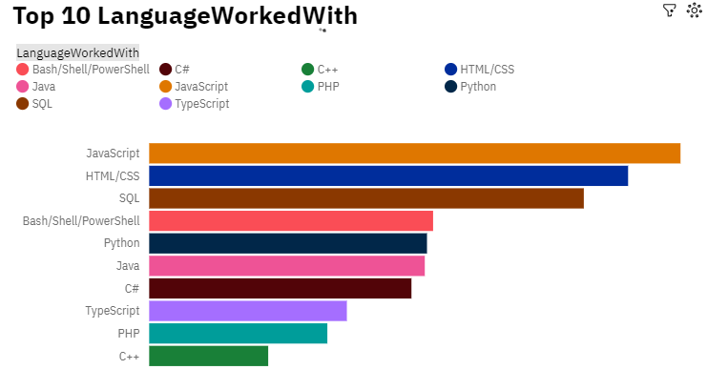
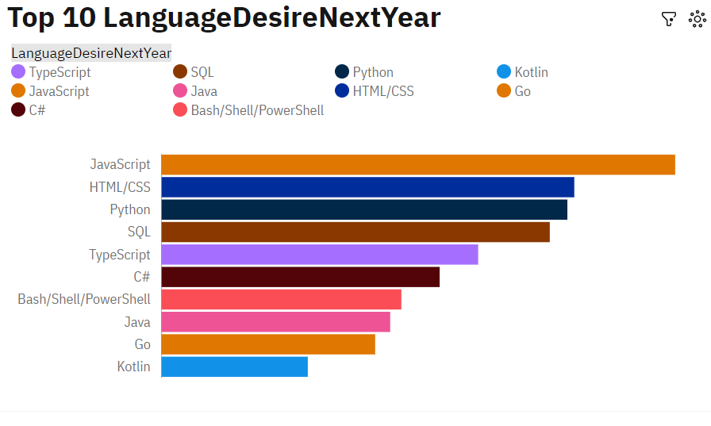
PROGRAMMING LANGUAGE TRENDS
Current Year
Next Year

Slide 8
PROGRAMMING LANGUAGE TRENDS - FINDINGS & IMPLICATIONS
Findings
JavaScript is the leading language.
Python, Java and c# are growing languages.
C++ is in the last level.
Implications
JavaScript is in the same level for next year.
Python is interesting language.
Sql and Typescript is still preferable.

Slide 9
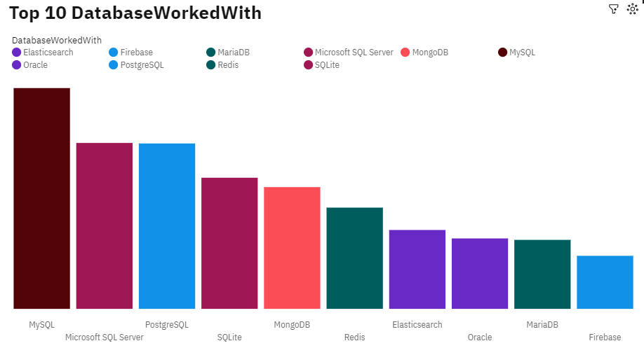
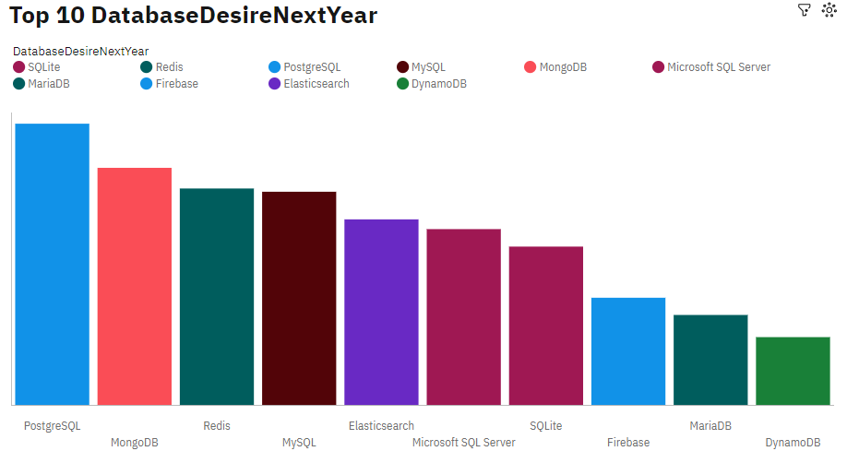
DATABASE TRENDS
Current Year
Next Year

Slide 10
DATABASE TRENDS - FINDINGS & IMPLICATIONS
Findings
MYSQL is the leading language.
Microsoft SQL Server and Postgre SQL server are in same level.
MongoDB is in the fifth level.
Implications
Postgre SQL is presented to be first level.
MongoDB becomes the second level in next year.
MYSQL is mostly requirement to use.

Slide 11

DASHBOARD
https://github.com/suvethababuji/Capstone-Project/blob/main/CapstoneProject.pdf

Slide 12
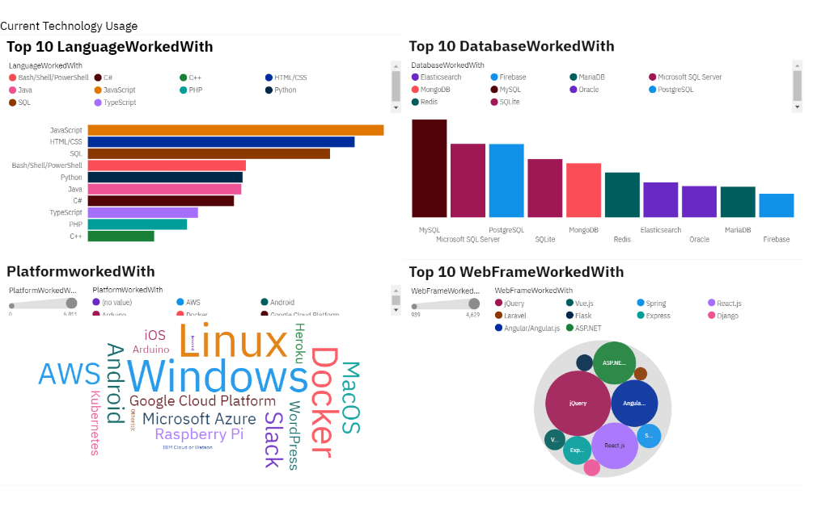
DASHBOARD TAB 1

Slide 13
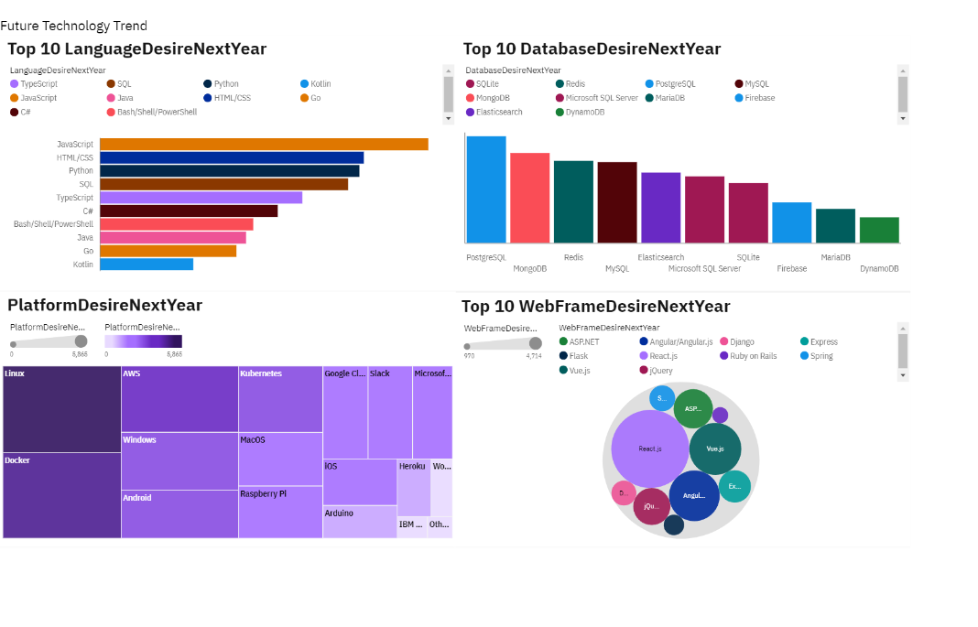
DASHBOARD TAB 2

Slide 14
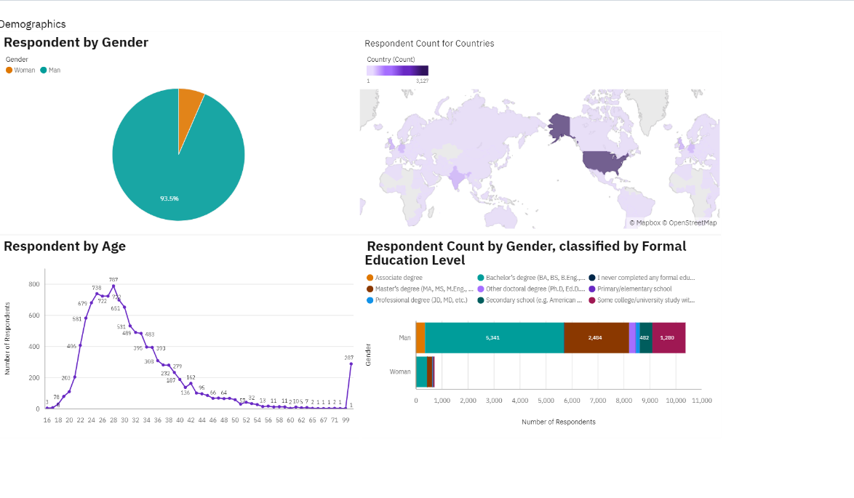
DASHBOARD TAB 3
Screenshot of dashboard tab 3 goes here

Slide 15
DISCUSSION
Languages, Databases and Web Frames are varying from the current year to next year.
Based on that job postings can differ.

Slide 16
OVERALL FINDINGS & IMPLICATIONS
Findings
JavaScript is the widely used language.
Over 93.5% of male is developer.
Typescript is getting popular.
Developers without post graduate degree is in majority.
Implications
Developers are mostly in developed countries.
Linux platform is most widely used in the environment.
JQuery Web Frame is most widely used.

Slide 17

CONCLUSION
By the Dashboard Top 10 languages, Databases and Web Frames are identified.
Developers are mostly from developed countries.
Linux, Docker and Aws are in trends.

Slide 18

APPENDIX

Slide 19
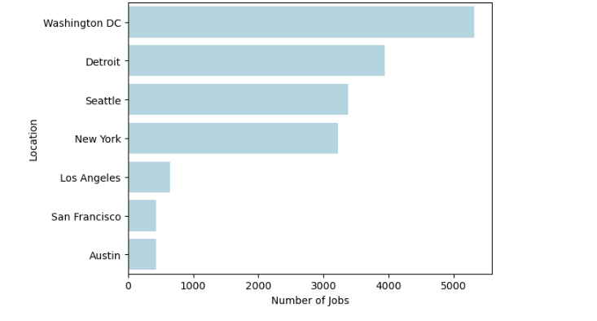
JOB POSTINGS

Slide 20
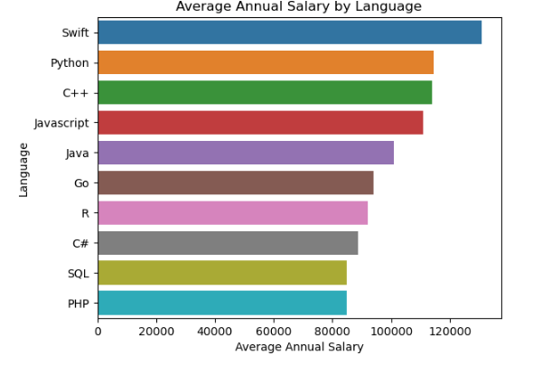
POPULAR LANGUAGES

